Slide 1
Sorting
As much as 25% of computing time is spent on sorting. Sorting aids searching and matching entries in a list.
Sorting Definitions:
  Given a list of records (R₁, R₂, ..., R_{n})
  Each record R_{i} has a key K_{i}.
  An ordering relationship (<) between two key values, either x = y, x < y, or x > y. Ordering relationships are transitive: x < y, y < z, then x < z.
  Find a permutation (π) of the keys such that K_{π(i)} ≤ K_{π(i+1)}, for 1 ≤ i < n.
  The desired ordering is: (R_{π(1)}, R_{π(2)}, ..., R_{π(n)})

Slide 2
Sorting
Stability: Since a list could have several records with the same key, the permutation is not unique. A permutation π is stable if:
  sorted: K_{π(i)} ≤ K_{π(i+1)}, for 1 ≤ i < n.
  stable: if i < j and K_{i} = K_{j} in the input list, then R_{i} precedes R_{j} in the sorted list.
An internal sort is one in which the list is small enough to sort entirely in main memory.
An external sort is one in which the list is too big to fit in main memory.
Complexity of the general sorting problem: Θ(n log n). Under some special conditions, it is possible to perform sorting in linear time.

Slide 3
Applications of Sorting
One reason why sorting is so important is that once a set of items is sorted, many other problems become easy.
Searching: Binary search lets you test whether an item is in a dictionary in O(log n) time. Speeding up searching is perhaps the most important application of sorting.
Closest pair: Given n numbers, find the pair which are closest to each other. Once the numbers are sorted, the closest pair will be next to each other in sorted order, so an O(n) linear scan completes the job.

Slide 4
Applications of Sorting
Element uniqueness: Given a set of n items, are they all unique or are there any duplicates? Sort them and do a linear scan to check all adjacent pairs. This is a special case of closest pair above.
Frequency distribution – Given a set of n items, which element occurs the largest number of times? Sort them and do a linear scan to measure the length of all adjacent runs.
Median and Selection: What is the kth largest item in the set? Once the keys are placed in sorted order in an array, the kth largest can be found in constant time by simply looking in the kth position of the array.

Slide 5
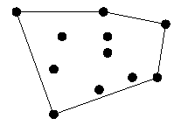
Applications: Convex Hulls
Given n points in two dimensions,
find the smallest area polygon
which contains them all.
The convex hull is like a rubber
band stretched over the points.
Convex hulls are the most important building block for more sophisticated geometric algorithms.
Once you have the points sorted by x-coordinate, they can be inserted from left to right into the hull, since the rightmost point is always on the boundary. Without sorting the points, we would have to check whether the point is inside or outside the current hull. Adding a new rightmost point might cause others to be deleted.

Slide 6
Applications: Huffman Codes
If you are trying to minimize the amount of space a text file is taking up, it is silly to assign each letter the same length (i.e., one byte) code.
Example: e is more common than q, a is more common than z.
If we were storing English text, we would want a and e to have shorter codes than q and z.
To design the best possible code, the first and most important step is to sort the characters in order of frequency of use.

Slide 7
Sorting Methods Based on D&C
Big Question: How to divide input file?
Divide based on number of elements (and not their values):
  Divide into files of size 1 and n-1
    Insertion sort
      Sort A[1], ..., A[n-1]
      Insert A[n] into proper place.
  Divide into files of size n/2 and n/2
    Mergesort
      Sort A[1], ..., A[n/2]
      Sort A[n/2+1], ..., A[n]
      Merge together.
  For these methods, divide is trivial, merge is nontrivial.

Slide 8
Sorting Methods Based on D&C
Divide file based on some values:
  Divide based on the minimum (or maximum)
    Selection sort, Bubble sort, Heapsort
      Find the minimum of the file
      Move it to position 1
      Sort A[2], ..., A[n].
  Divide based on some value (Radix sort, Quicksort)
    Quicksort
      Partition the file into 3 subfiles consisting of:
      elements < A[1], = A[1], and > A[1]
      Sort the first and last subfiles
      Form total file by concatenating the 3 subfiles.
  For these methods, divide is non-trivial, merge is trivial.

Slide 9
Selection Sort
3 6 2 7 4 8 1 5
1 6 2 7 4 8 3 5
1 2 6 7 4 8 3 5
1 2 3 7 4 8 6 5
1 2 3 4 7 8 6 5
1 2 3 4 5 8 6 7
1 2 3 4 5 6 8 7
1 2 3 4 5 6 7 8
n exchanges
n²/2 comparisons
for i := 1 to n-1 do
begin
min := i;
for j := i + 1 to n do
if a[j] < a[min] then min := j;
swap(a[min], a[i]);
end;
Selection sort is linear for files with large record and small keys

Slide 10
Insertion Sort
3 6 2 7 4 8 1 5
2 3 6 7 4 8 1 5
2 3 4 6 7 8 1 5
1 2 3 4 6 7 8 5
1 2 3 4 5 6 7 8
n²/4 exchanges
n²/4 comparisons
for i := 2 to n do
begin
v := a[i]; j := i;
while a[j-1] > v do
begin a[j] := a[j-1]; j := j-1 end;
a[j] := v;
end;
linear for "almost sorted" files
Binary insertion sort: Reduces comparisons but not moves.
List insertion sort: Use linked list, no moves, but must use sequential search.

Slide 11
Bubble Sort
3 6 2 7 4 8 1 5
3 2 6 4 7 1 5 8
2 3 4 6 1 5 7 8
2 3 4 1 5 6 7 8
2 3 1 4 5 6 7 8
2 1 3 4 5 6 7 8
1 2 3 4 5 6 7 8
for i := n down to 1 do
for j := 2 to i do
if a[j-1] > a[j]
then swap(a[j], a[j-1]);
n²/4 exchanges
n²/2 comparisons
Bubble can be improved by adding a flag to check if the list has already been sorted.

Slide 12
Shell Sort
h := 1;
repeat h := 3*h+1 until h>n;
repeat
h := h div 3;
for i := h+1 to n do
begin
v := a[i]; j:= i;
while j>h & a[j-h]>v do
begin
a[j] := a[j-h]; j := j - h;
end;
a[j] := v;
end;
until h = 1;
Shellsort is a simple extension of insertion sort, which gains speeds by allowing exchange of elements that are far apart.
Idea: rearrange list into h-sorted (for any sequence of values of h that ends in 1.)
Shellsort never does more than n^{1.5} comparisons (for the h = 1, 4, 13, 40, ...).
The analysis of this algorithm is hard. Two conjectures of the complexity are n(log n)² and n^{1.25}

Slide 13
Example
I P D G L Q A J C M B E O F N H K (h = 13)
I H D G L Q A J C M B E O F N P K (h = 4)
C F A E I H B G K M D J L Q N P O (h = 1)
A B C D E F G H I J K L M N O P Q

Slide 14
Distribution counting
Sort a file of n records whose keys are distinct integers between 1 and n. Can be done by
for i := 1 to n do t[a[i]] := i.
Sort a file of n records whose keys are integers between 0 and m-1.
for j := 0 to m-1 do count[j] := 0;
for i := 1 to n do count[a[i]] := count[a[i]] + 1;
for j := 1 to m -1 do count[j] := count[j-1] + count[j];
for i := n downto 1 do begin t[count[a[i]]] := a [i]; count[a[i]] := count[a[i]] -1 end;
for i := 1 to n do a[i] := t[i];

Slide 15
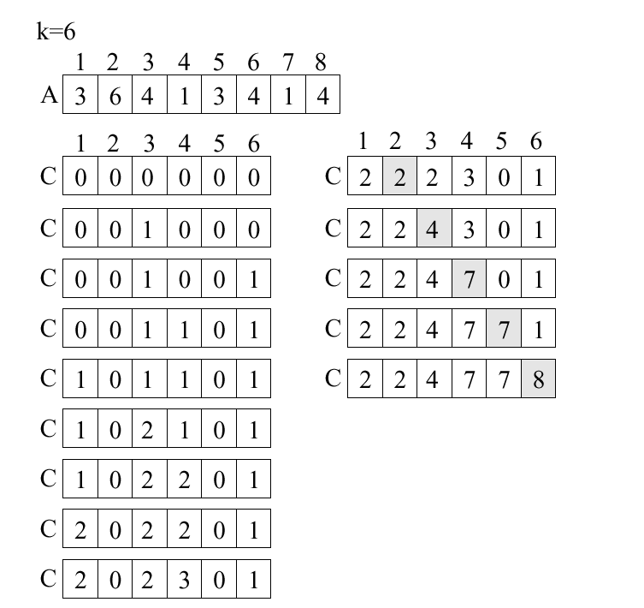

Slide 16
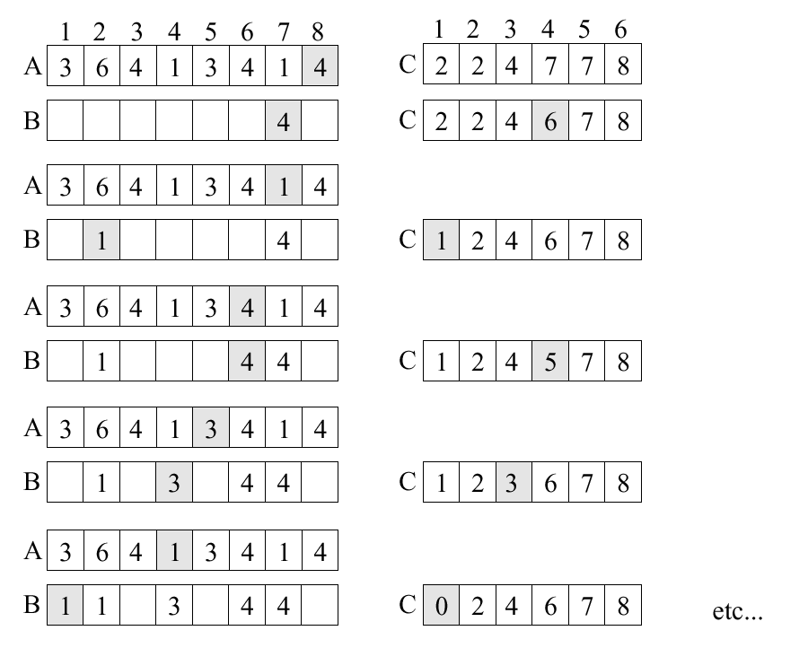

Slide 17
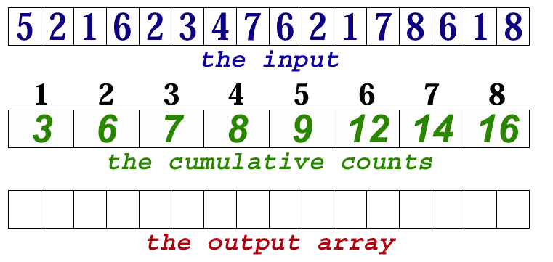
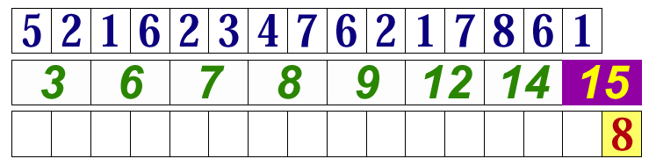
Example (1)

Slide 18
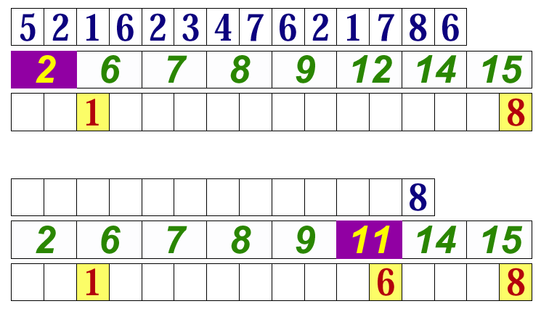
Example (2)

Slide 19
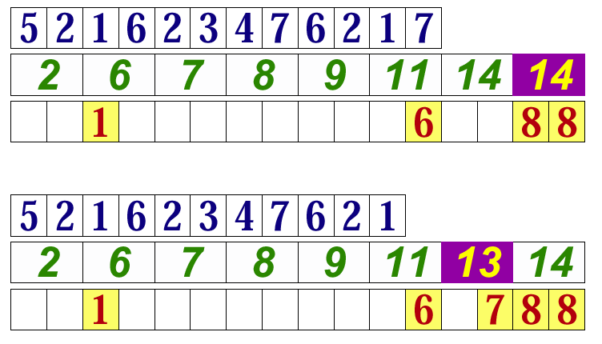
Example (3)

Slide 20
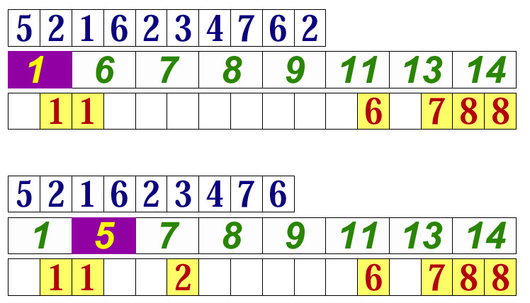
Example (4)

Slide 21
Radix Sort
(Straight) Radix-Sort: sorting d digit numbers for a fixed constant d.
While proceeding from LSB towards MSB, sort digit-wise with a linear time stable sort.
Radix-Sort is a stable sort.
The running time of Radix-Sort is d times the running time of the algorithm for digit-wise sorting.
Can use counting sort to do this.

Slide 22
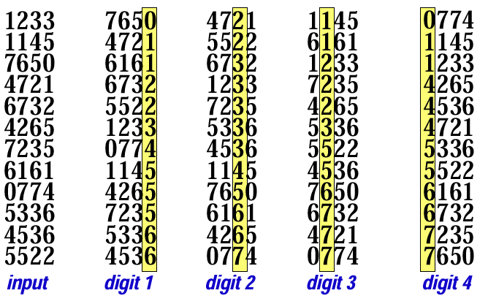
Example

Slide 23
Bucket-Sort
Bucket-Sort: sorting numbers in the interval U = [0; 1).
For sorting n numbers,
  partition U into n non-overlapping intervals, called buckets,
  put the input numbers into their buckets,
  sort each bucket using a simple algorithm, e.g., Insertion-Sort,
  concatenate the sorted lists
What is the worst case running time of Bucket-Sort?

Slide 24
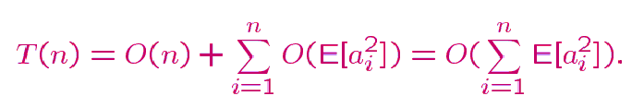
Analysis
O(n) expected running time
Let T(n) be the expected running time. Assume the numbers appear under the uniform distribution.
For each i, 1 ≤ i ≤ n, let a_{i} = # of elements in the i-th bucket. Since Insertion-Sort has a quadratic running time,

Slide 25
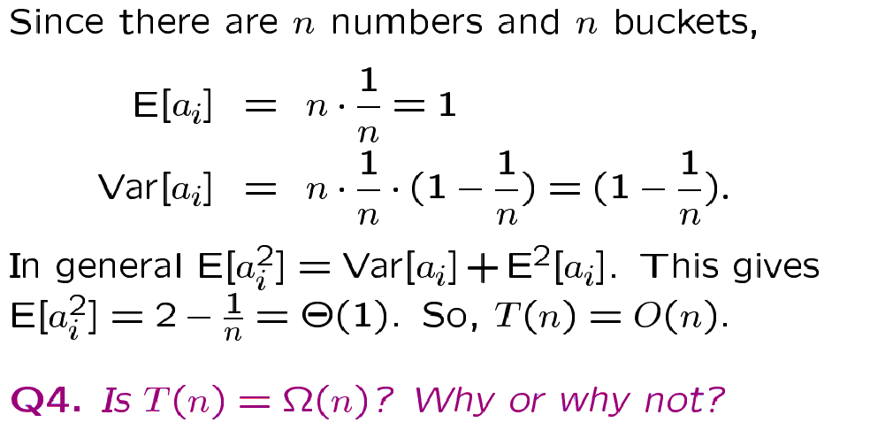
Analysis Continued
Bucket-Sort: expected linear-time, worst-case quadratic time.

Slide 26
Quicksort
Quicksort is a simple divide-and-conquer sorting algorithm that practically outperforms Heapsort.
In order to sort A[p..r] do the following:
  Divide: rearrange the elements and generate two subarrays A[p..q] and A[q+1..r] so that every element in A[p..q] is at most every element in A[q+1..r];
  Conquer: recursively sort the two subarrays;
  Combine: nothing special is necessary.
In order to partition, choose u = A[p] as a pivot, and move everything < u to the left and everything > u to the right.

Slide 27
Quicksort
Although mergesort is O(n log n), it is quite inconvenient for implementation with arrays, since we need space to merge.
In practice, the fastest sorting algorithm is Quicksort, which uses partitioning as its main idea.

Slide 28
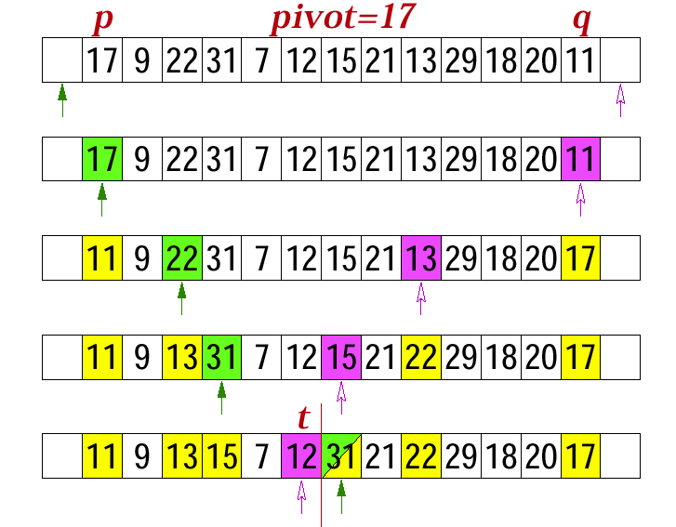
Partition Example (Pivot=17)

Slide 29
Partition Example (Pivot=5)
3 6 2 7 4 8 1 5
3 1 2 7 4 8 6 5
3 1 2 4 7 8 6 5
3 1 2 7 4 8 6 5 ⬅
3 1 2 4 5 8 6 7
• • • •
3 1 2 4 5 6 7 8
• • • •
1 2 3 4 5 6 7 8
The efficiency of quicksort can be measured by the number of comparisons.

Slide 30
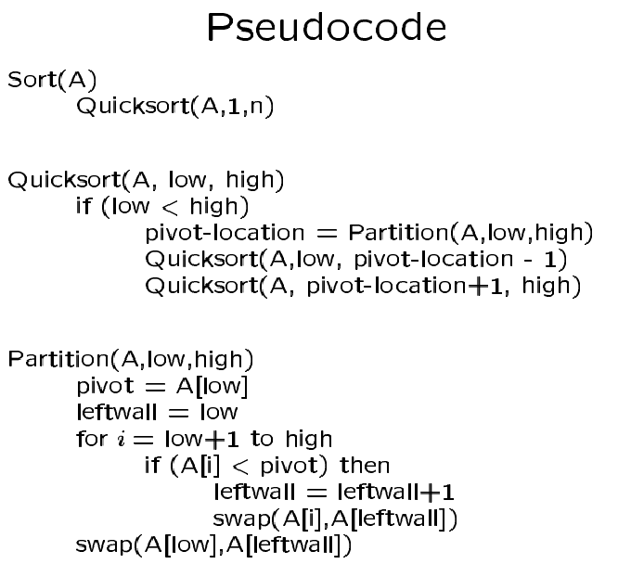

Slide 31
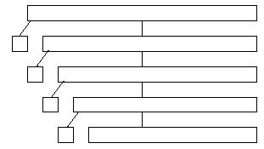
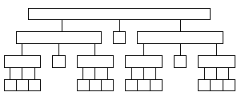
Analysis
Worst-case: If A[1..n] is already sorted, then Partition splits A[1..n] into A[1] and A[2..n] without changing the order. If that happens, the running time C(n) satisfies:
C(n) = C(1) + C(n –1) + Θ(n) = Θ(n²)
Best case: Partition keeps splitting the subarrays into halves. If that happens, the running time C(n) satisfies:
C(n) ≈ 2 C(n/2) + Θ(n) = Θ(n log n)

Slide 32
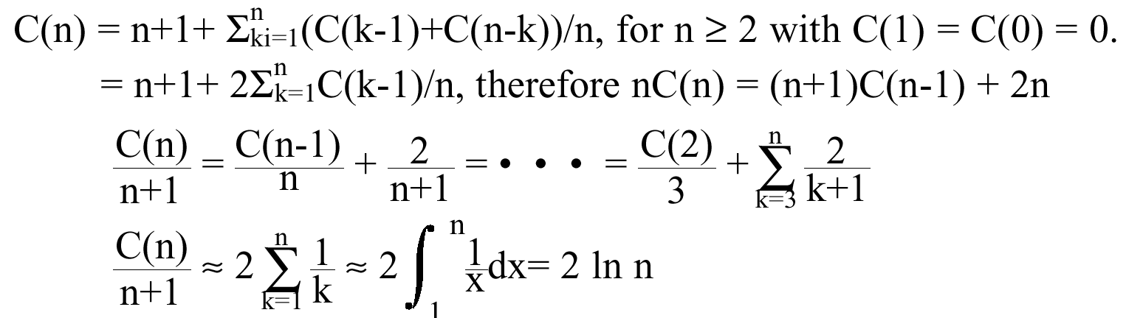
Analysis
Average case (for random permutation of n elements):
C(n) ≈ 1.38 n log n which is about 38% higher than the best case.

Slide 33
Comments
Sort smaller subfiles first reduces stack size asymptotically at most O(log n). Do not stack right subfiles of size < 2 in recursive algorithm -- saves factor of 4.
Use different pivot selection, e.g. choose pivot to be median of first last and middle.
Randomized-Quicksort: turn bad instances to good instances by picking up the pivot randomly

Slide 34
Priority Queue
Priority queue: an appropriate data structure that allows inserting a new element and finding/deleting the smallest (largest) element quickly.
Typical operations on priority queues:
  Create a priority queue from n given items;
  Insert a new item;
  Delete the largest item;
  Replace the largest item with a new item v (unless v is larger);
  Change the priority of an item;
  Delete an arbitrary specified item;
  Join two priority queues into a larger one.

Slide 35
Implementation
As a linked list or an array:
  insert: O(1)
  deleteMax: O(n)
As a sorted array:
  insert: O(n)
  deleteMax: O(1)
As binary search trees (e.g. AVL trees)
  insert: O(log n)
  deleteMax: O(log n)
Can we do better? Is binary search tree an overkill?
Solution: an interesting class of binary trees called heaps

Slide 36
Heap
Heap: A (max) heap is a complete binary tree with the property that the value at each node is at least as large as the values at its children (if they exist).
A complete binary tree can be stored in an array:
  root -- position 1
  level 1 -- positions 2, 3
  level 2 -- positions 4, 5, 6, 7
  • • •
For a node i, the parent is ⎣i/2⎦, the left child is 2i, and the right child is 2i +1.

Slide 37
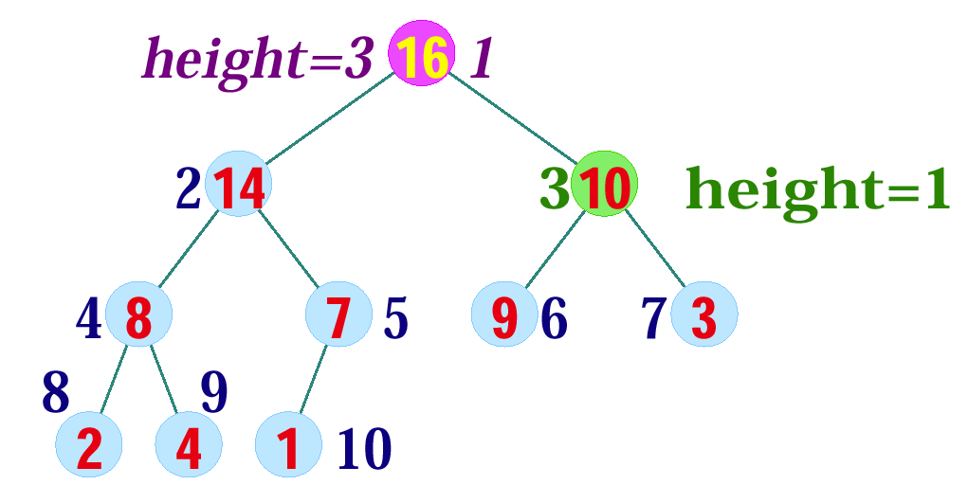
Example
The following heap corresponds to the array
A[1..10]: 16, 14, 10, 8, 7, 9, 3, 2, 4, 1

Slide 38
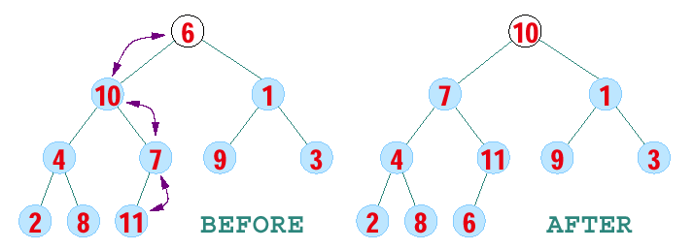
Heapify
Heapify at node i: looks at A[i] and A[2i] and A[2i + 1], the values at the children of i. If the heap-property does not hold w.r.t. i, exchange A[i] with the larger of A[2i] and A[2i+1], and recurse on the child with respect to which exchange took place.
The number of exchanges is at most the height of the node, i.e., O(log n).

Slide 39
Pseudocode
Heapify(A,i)
left = 2i
right = 2i +1
if (left ≤ n) and(A[left] > A[i])
then max = left
else max = i
if (right ≤ n) and (A(right] > A[max])
then max = right
if (max ≠ i)
then swap(A[i], A[max])
Heapify(A, max)

Slide 40
Analysis
Heapify on a subtree containing n nodes takes
T(n) ≤ T(2n/3) + O(1)
The 2/3 comes from merging heaps whose levels differ by one. The last row could be exactly half filled.
Besides, the asymptotic answer won't change so long the fraction is less than one.
By the Master Theorem, let a = 1, b = 3/2, f(n) = O(1).
Note that Θ(n^{log3/21}) = Θ(1), since log_{3/2}1 =0.
Thus, T(n) = Θ(log n)

Slide 41
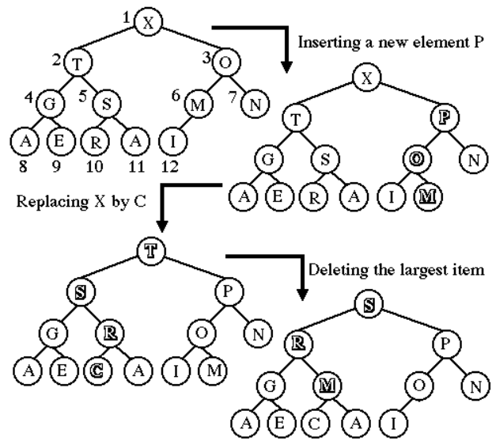
Example of Operations

Slide 42
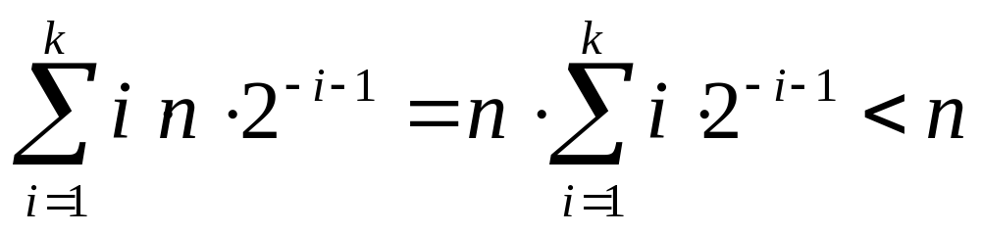
Heap Construction
Bottom-up Construction: Create a heap from n given items can be done in O(n) time by:
for i := n div 2 downto 1 do heapify(i);
Why correct? Why linear time?
cf. Top down construction of a heap takes O(n log n) time.

Slide 43
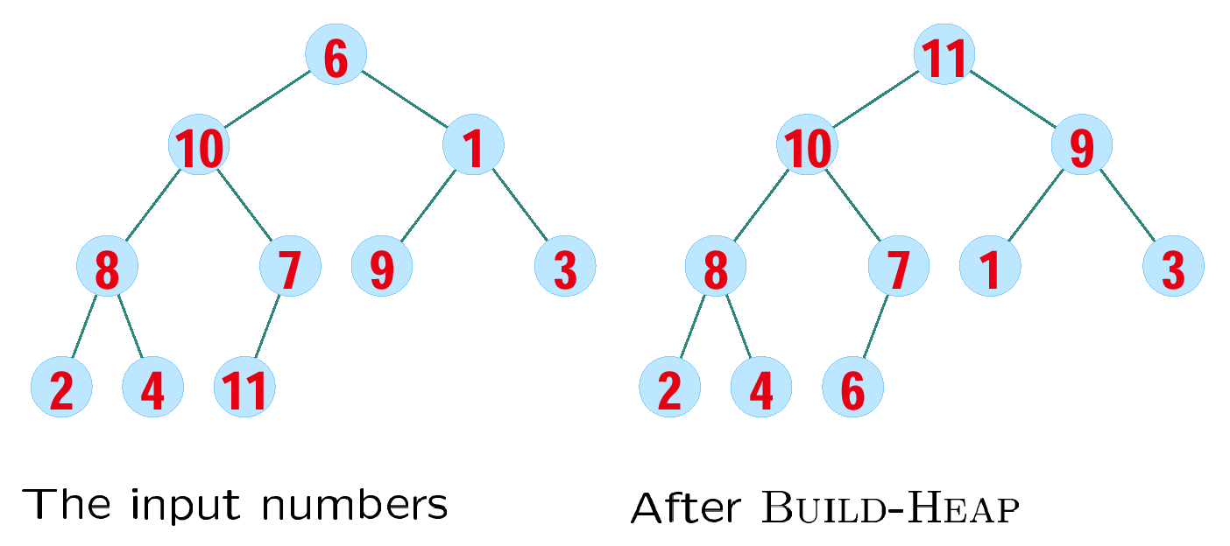
Example

Slide 44
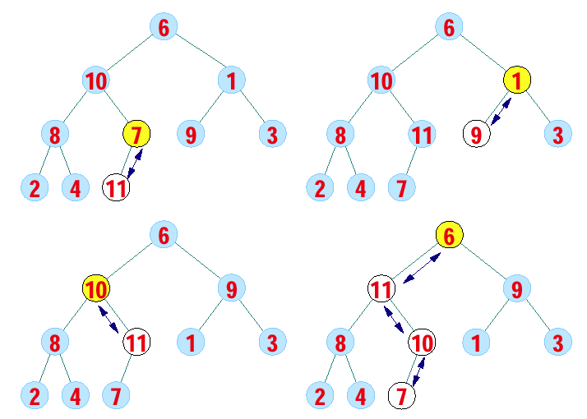
Example

Slide 45
Partial Order
The ancestor relation in a heap defines a partial order on its elements:
  Reflexive: x is an ancestor of itself.
  Anti-symmetric: if x is an ancestor of y and y is an ancestor of x, then x = y.
  Transitive: if x is an ancestor of y and y is an ancestor of z, x is an ancestor of z.
Partial orders can be used to model hierarchies with incomplete information or equal-valued elements.
The partial order defined by the heap structure is weaker than that of the total order, which explains
  Why it is easier to build.
  Why it is less useful than sorting (but still very important).

Slide 46
Heapsort
procedure heapsort;
var k, t:integer;
begin
m := n;
for i := m div 2 downto 1 do heapify(i);
repeat swap(a[1],a[m]);
m:=m-1;
heapify(1)
until m ≤ 1;
end;

Slide 47
Comments
Heap sort uses ≤ 2n log n (worst and average) comparisons to sort n elements.
Heap sort requires only a fixed amount of additional storage.
Slightly slower than merge sort that uses O(n) additional space.
Slightly faster than merge sort that uses O(l) additional space.
In greedy algorithms, we always pick the next thing which locally maximizes our score. By placing all the things in a priority queue and pulling them off in order, we can improve performance over linear search or sorting, particularly if the weights change.

Slide 48
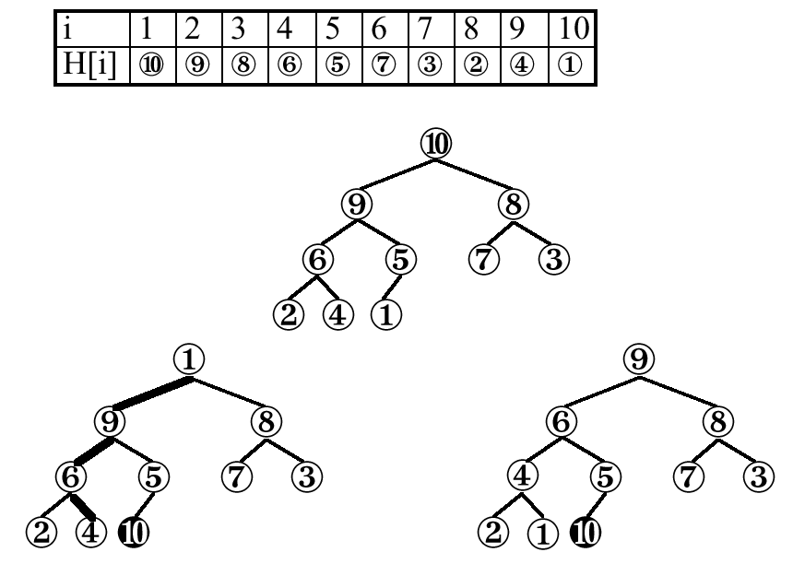
Example

Slide 49
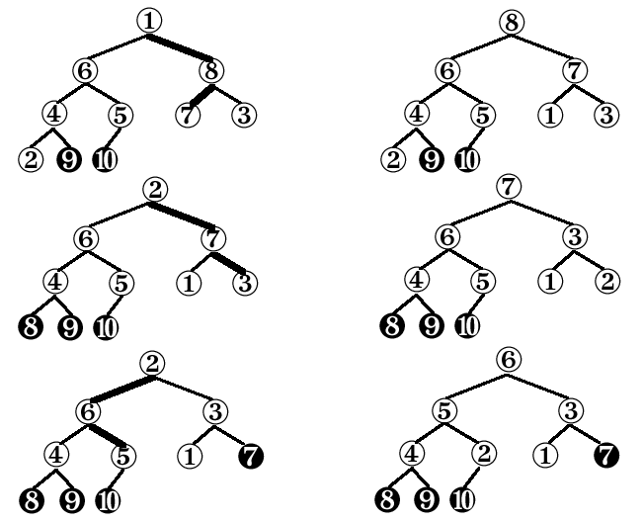
Example

Slide 50
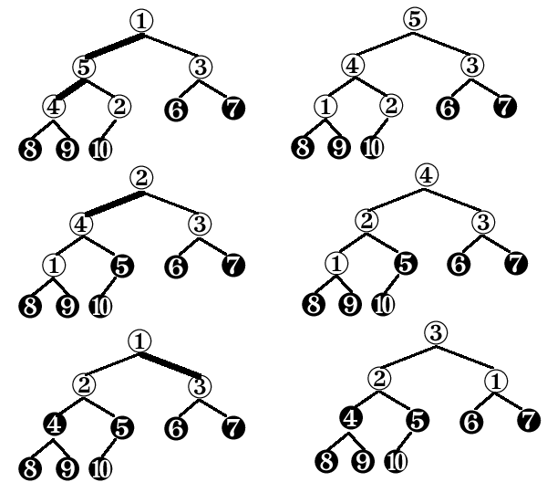
Example

Slide 51
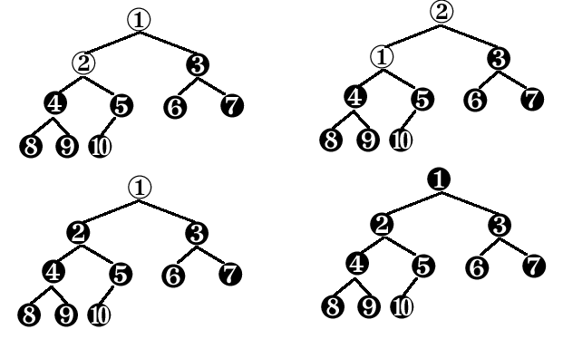
Example

Slide 52
Example

Slide 53
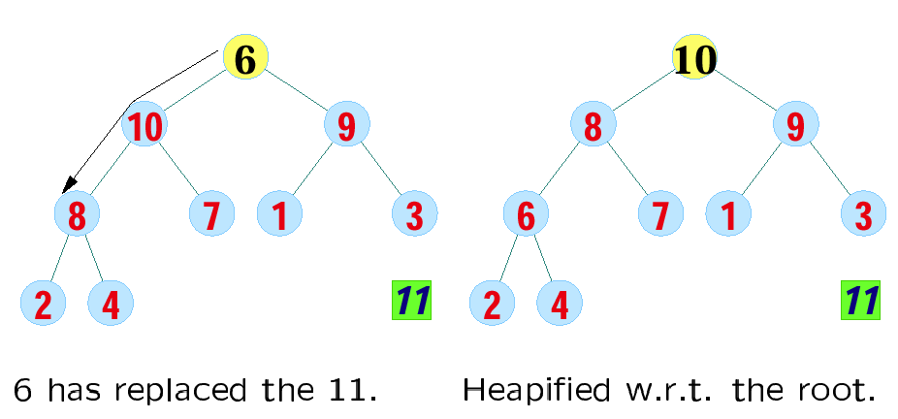
Example

Slide 54
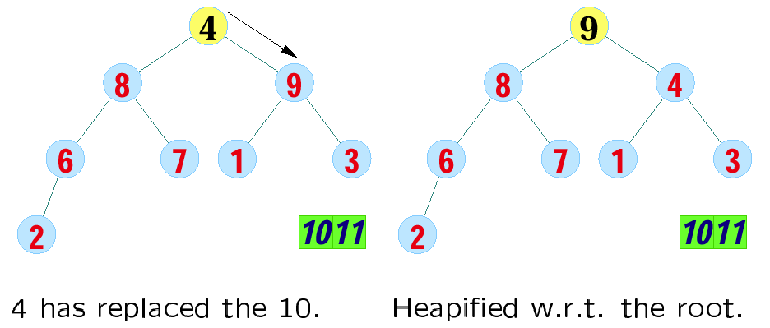
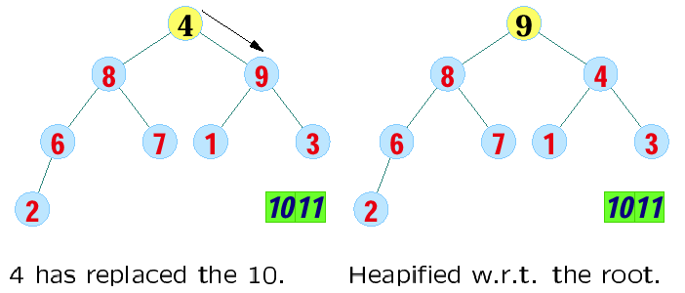
Example

Slide 55
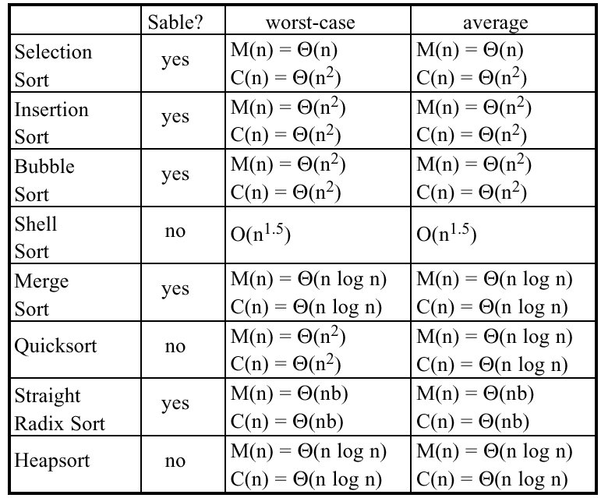
Summary
M(n): # of data movements
C(n): # of key comparisons

Slide 56
Characteristic Diagrams
key value
before execution during execution after execution
Index

Slide 57
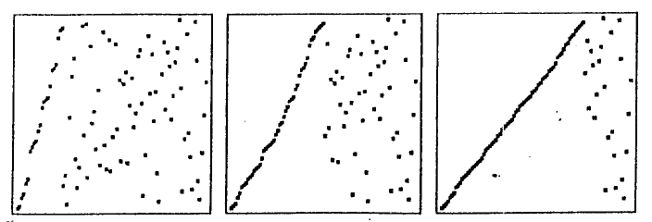
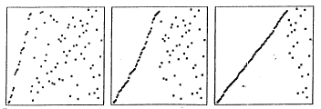
Insertion Sorting a Random Permutation

Slide 58
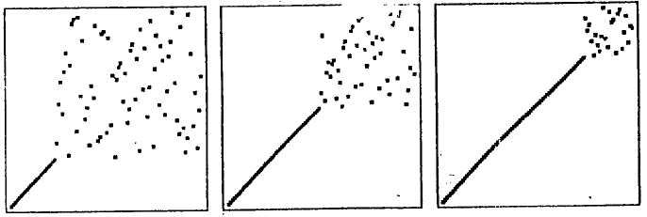
Selection Sorting a Random Permutation

Slide 59
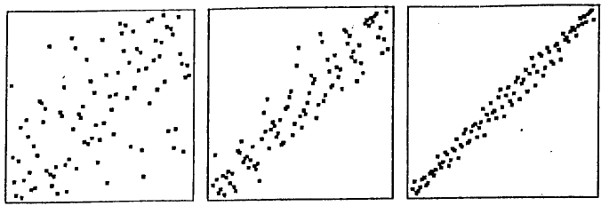
Shell Sorting a Random Permutation

Slide 60
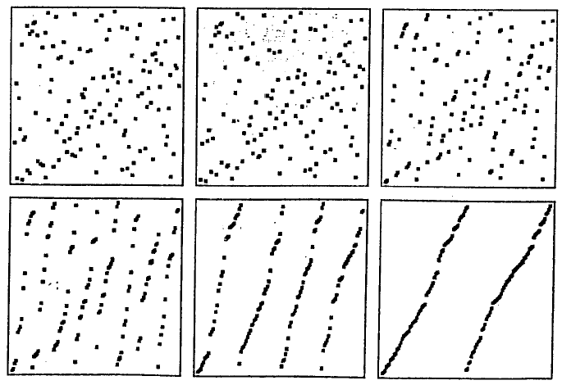
Merge Sorting a Random Permutation

Slide 61
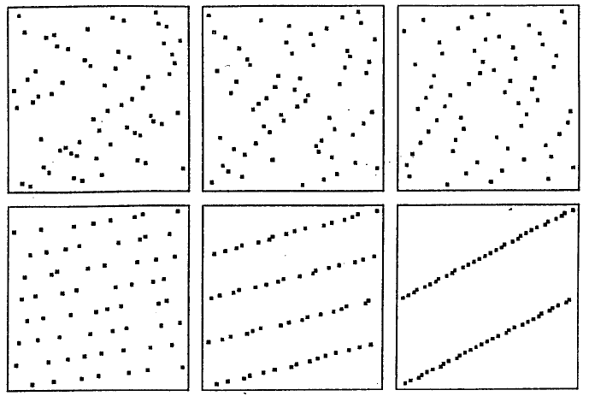
Stages of Straight Radix Sort

Slide 62
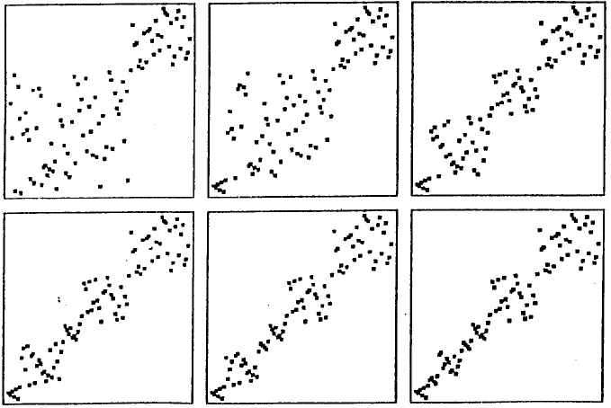
Quicksort (recursive implementation, M=12)

Slide 63
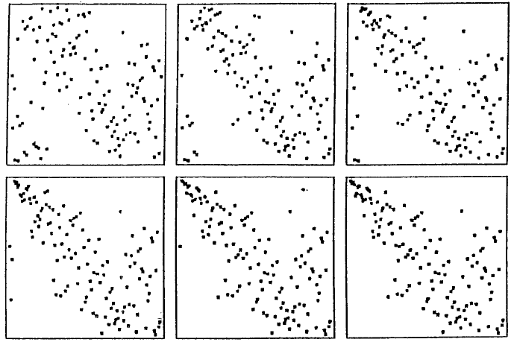
Heapsorting a Random Permutation: Construction

Slide 64
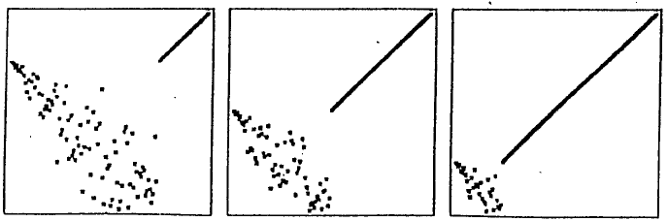
Heapsorting (Sorting Phase)

Slide 65
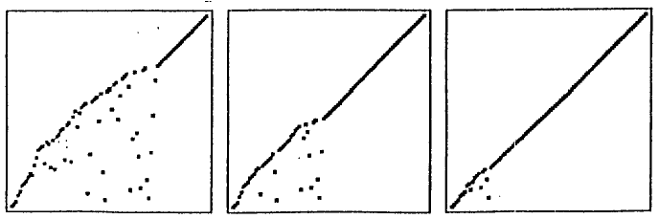
Bubble Sorting a Random Permutation

